Slide 1
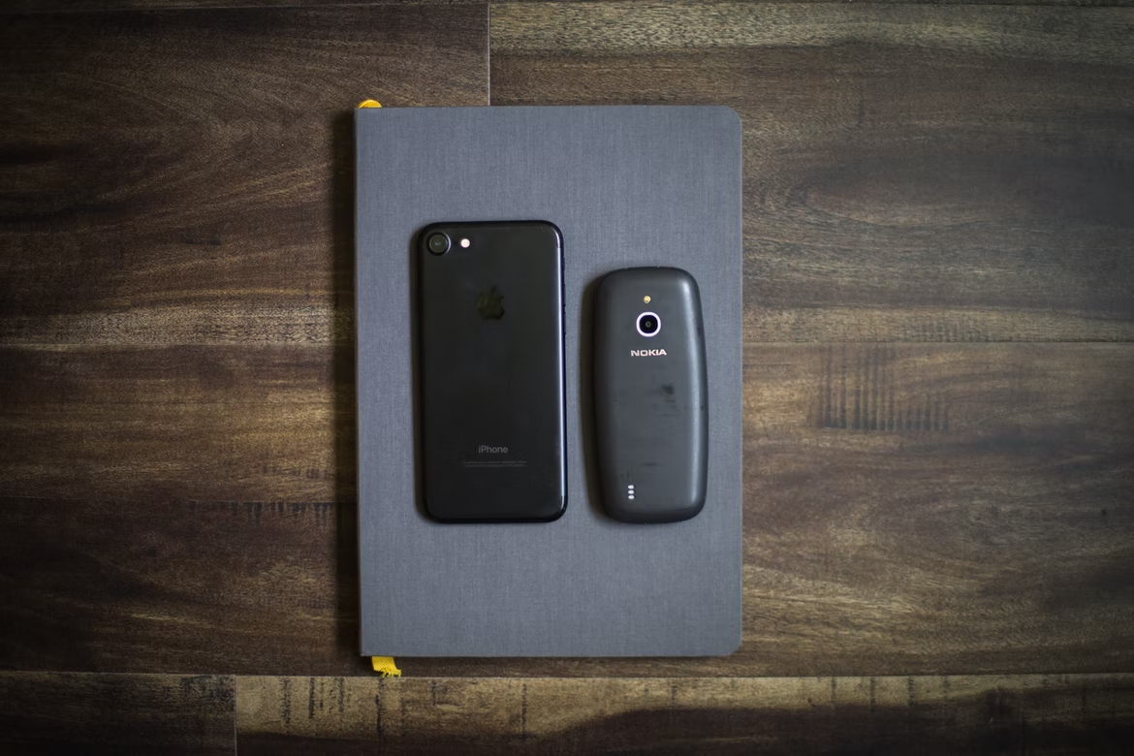
Comparative and Superlative Adjectives
https://unsplash.com/photos/_4_8WLZ99KU

Slide 2
Adjectives
Describing words – describe nouns
Number
Personal opinions: quality, appearance, value
Size
Form / shape
Age
Color
Origin
Material (what is it made of?)

Slide 3
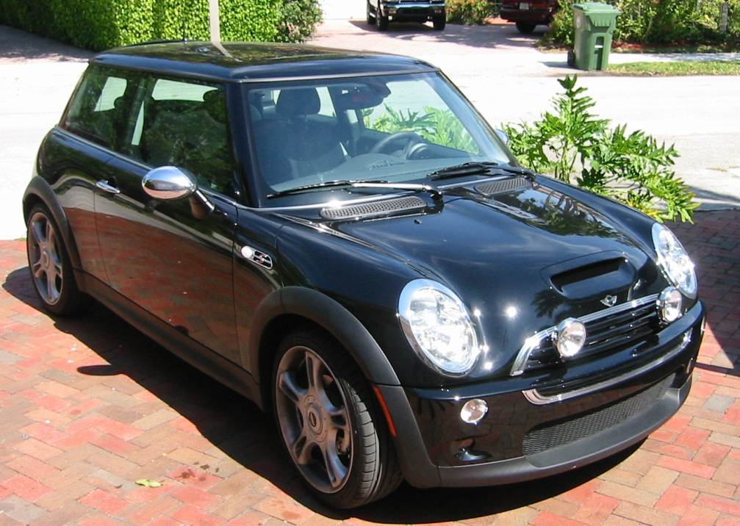
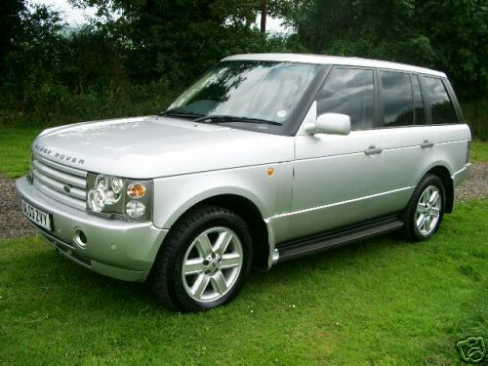
Comparatives
Car A
Car B
Long
Heavy
Fast
Economical
Comfortable
Expensive

Slide 4
Let’s compare
Car | Cost | Top speed | Gas | Length | Weight | Consumer Guide Rating
Car A | $19,400 - $34,300 | 80 mph | 29 mpg (city) 37 mpg (highway) | 10 ft | 1,386 lbs | 63 / 100
Car B | $35,700 - $35,700 | 104 mph | 12 mpg (city) 18 mpg (highway) | 15 ft | 4,188 lbs | 66 / 100

Slide 5
Comparative Spelling Rules
cheap
small
fast
slow
big
thin
hot
Never double w, x, y
One syllable adjective + er
One syllable adjective with final three letters consonant + vowel + consonant, double final consonant + er

Slide 6
Comparative Spelling Rules (2)
large
wide
One syllable adjective with final e + r

Slide 7
Comparative Spelling Rules (3)
pretty
easy
happy
busy
interesting
beautiful
handsome
intelligent
expensive
Adjective with final y, - y + ier
Adjective with more than one syllable,
add “more” in front

Slide 8

Irregular Comparative Adjectives
Memorize!
good
bad
far
https://pixabay.com/vectors/reminder-bow-red-ribbon-hand-23771/

Slide 9
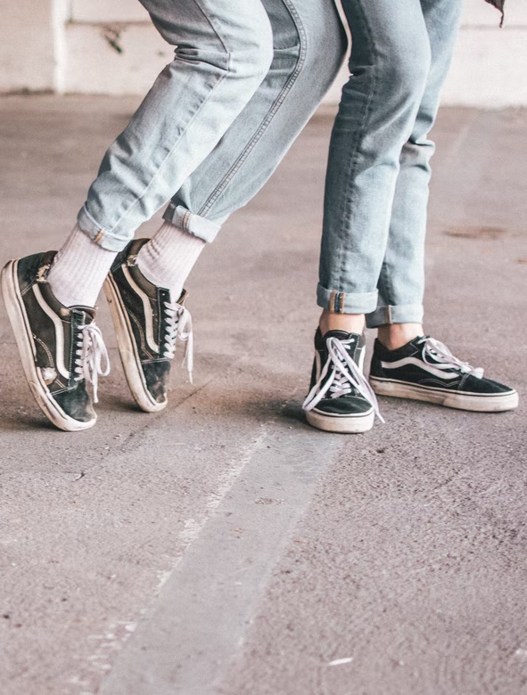
What if they are equal?
https://unsplash.com/photos/8W-p8SS6NJE
as __________ (adjective) as ____________

Slide 10
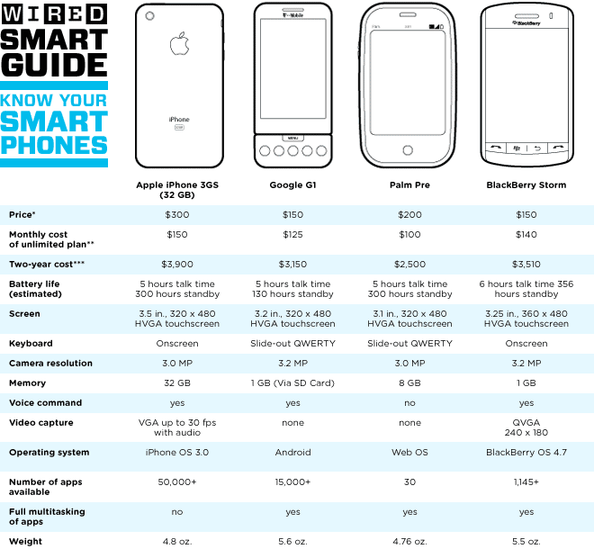
Superlatives
Comparing one against others in a group
Good
Bad
New
Old
Expensive
Cheap
Big
Small
Powerful
Heavy
Light
Other: _____________
Other: _____________
Other: _____________
Other: _____________
Source: https://www.wired.com/images_blogs/gadgetlab/2009/06/smart_guide2.gif

Slide 11
Superlative Spelling Rules
old
young
new
small
big
hot
Never double w, x, y
One syllable adjective + est
One syllable adjective with final three letters consonant + vowel + consonant, double final consonant + est

Slide 12
Superlative Spelling Rules (2)
large
wide
One syllable adjective with final e + st

Slide 13
Superlative Spelling Rules (3)
easy
happy
sunny
difficult
confusing
expensive
Adjective with final y, - y + iest
Adjective with more than one syllable,
add “the most” in front

Slide 14
Irregular Superlative Adjectives
Memorize!
good
bad
far
https://pixabay.com/vectors/reminder-bow-red-ribbon-hand-23771/

Slide 15

Any Questions?
https://pixabay.com/vectors/question-mark-question-1750942/

