Slide 1

Get Organized Day
April 26, 2024

Slide 2

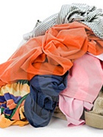
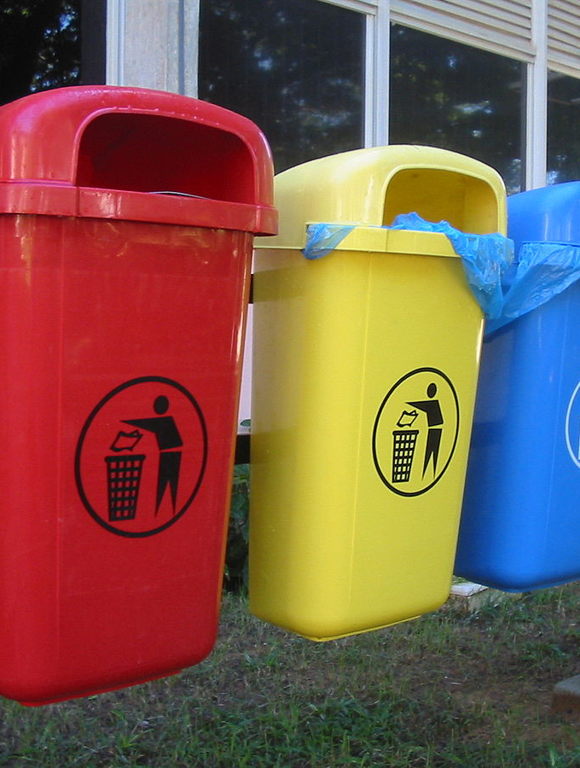
Organization comes in many forms:
Files
Piles
Colors
Jars
Containers, baskets
This Photo by Unknown Author is licensed under CC BY-SA
This Photo by Unknown Author is licensed under CC BY-NC-ND

Slide 3


We will go over some simple tips
Are you ready?
This Photo by Unknown Author is licensed under CC BY-SA

Slide 4
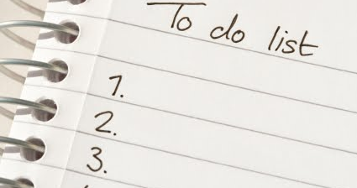
Tip # 1
Write things down
Make a list
This Photo by Unknown Author is licensed under CC BY-NC

Slide 5


Tip # 2
Make a schedule
Mark your calendar
This Photo by Unknown Author is licensed under CC BY-SA

Slide 6
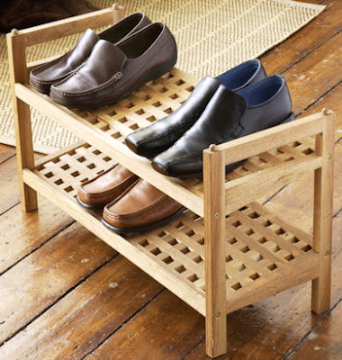
Tip #3
Give everything a home
This Photo by Unknown Author is licensed under CC BY-SA-NC

Slide 7
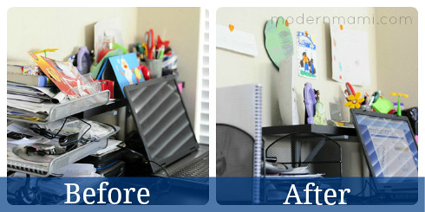
Tip # 4
Declutter regularly

Slide 8
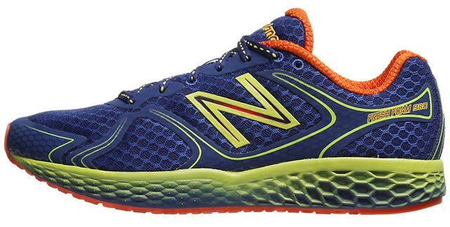
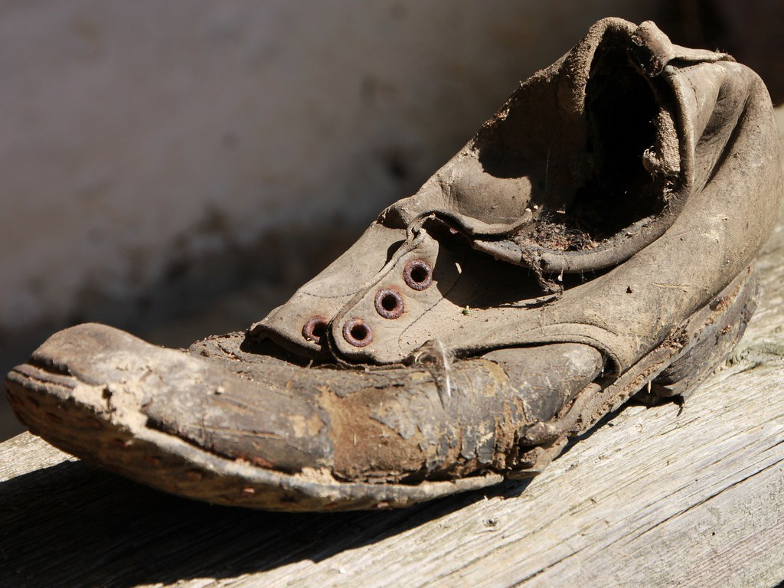
Tip # 5
One in,
One out
This Photo by Unknown Author is licensed under CC BY
This Photo by Unknown Author is licensed under CC BY-SA-NC

Slide 9
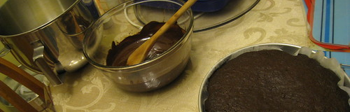
Tip # 6
Clean as you go
This Photo by Unknown Author is licensed under CC BY-SA

Slide 10
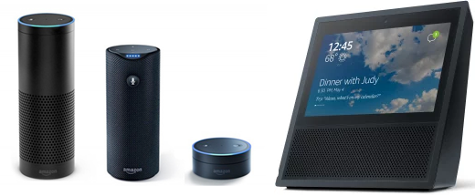
Tip # 7
Make a playlist
This Photo by Unknown Author is licensed under CC BY-SA

Slide 11



What are some tips that you use?

Slide 12
Information:
Checkiday.com
Google.com

